Slide 1
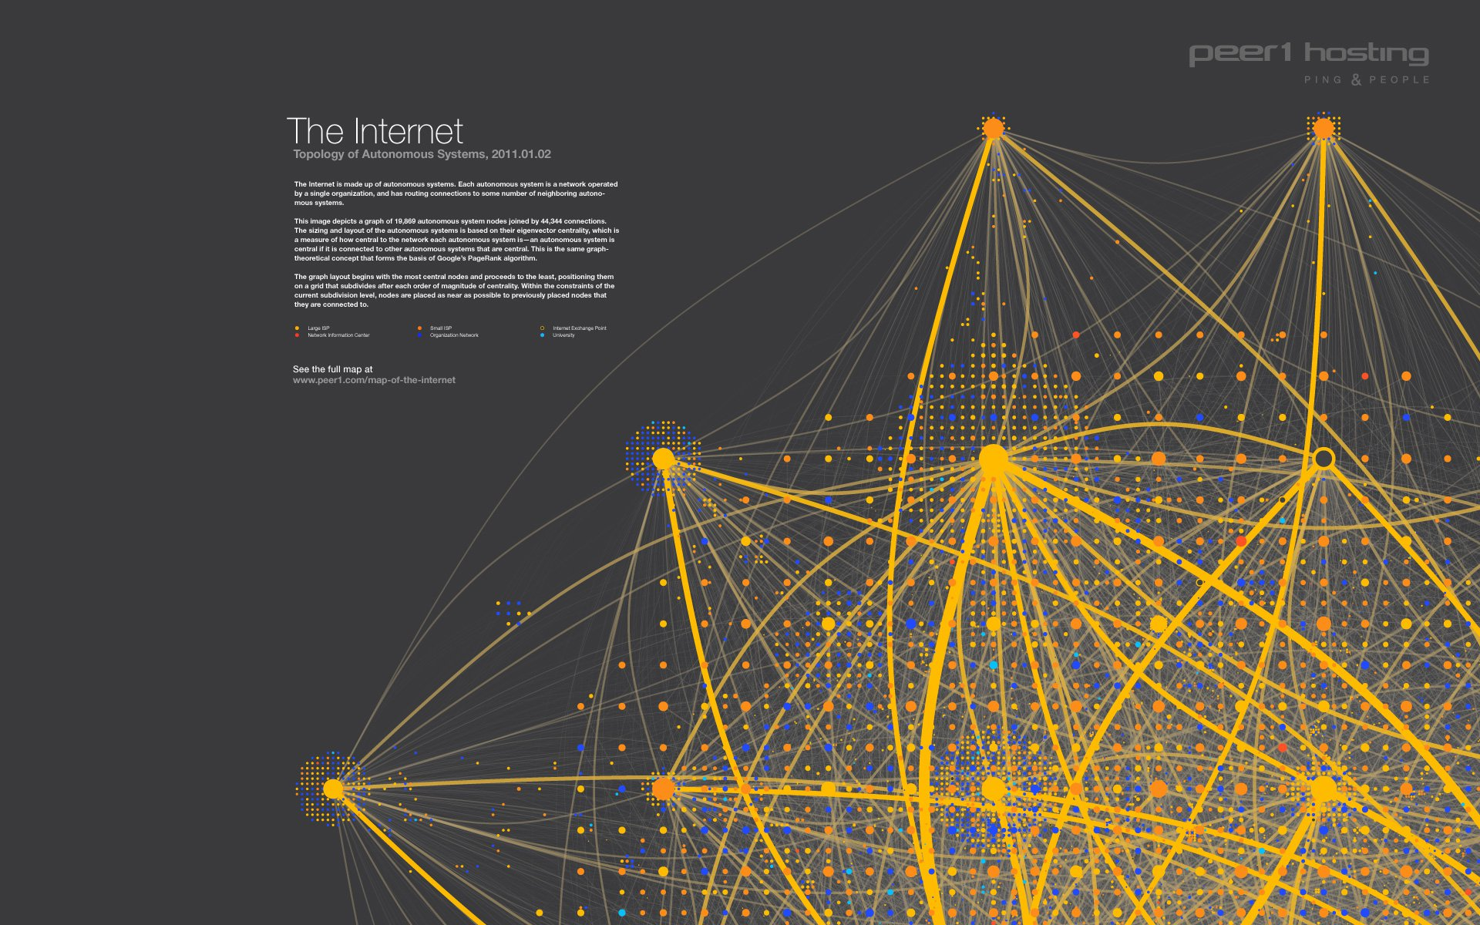
SIKA’S WAY TO NET ZERO
Utilizing Modern Data Architectures & Big Data To Reduce CO2 Emissions
IE UNIVERSITY | MODERN DATA ARCHITECURES & BIG DATA II
MASTERS IN BUSINESS ANALYTICS & BIG DATA
NOVEMBER, 2022
GROUP C PROJECT

Slide 2







INTRODUCTION (1/3)
MEET OUR TEAM - GROUP (C)
Jorge Sanz Sacristan
Nirmala Vinothnabu
Stephanie Gessler
Juan Francisco Horrillo
Prodromos Alampritis
Barbara Manzuoli
Aous Almegrin
2
Notes:
Present Team

Slide 3


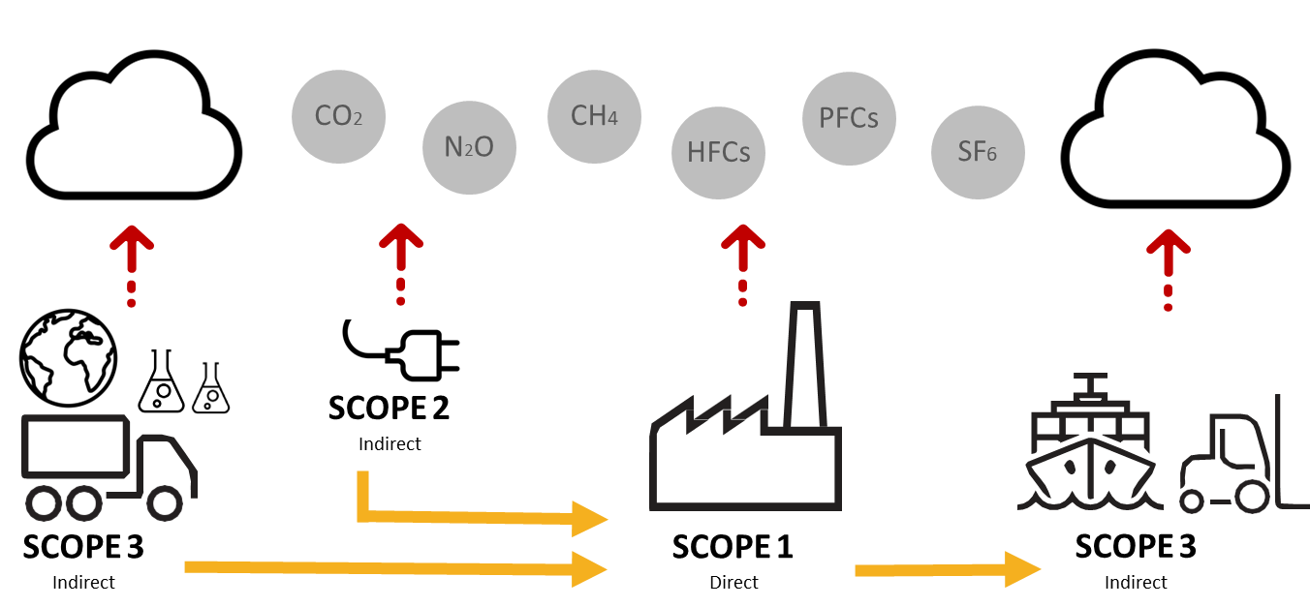
INTRODUCTION (2/3)
ABOUT THE COMPANY
ABOUT SIKA:
Sika is a specialty chemicals company with a leading position in the development and production of systems and products for bonding, sealing, damping, reinforcing, and protecting in the building sector and motor vehicle industry.
SIKA SUSTAINABILITY STRATEGY FOR ZERO NET EMISSION BY 2050:
SIKA’S EMISSION CATAGORIES
2032
2032
2050
-42%
-25%
-90%
Scope 1 and 2
Scope 3
Scope 1, 2 and 3
9%
OF SCOPE 3 EMISSIONS ARE FROM TRANSPORTATION SOURCES
3
Reduce the CO2eq emissions (scope 1 and 2) per ton sold by -12% until 2023

Slide 4
BUSINESS CHALLENGES TO BE ADDRESSED
PROJECT GOALS AND OBJECTIVES
BUSINESS CHALLENGES (SCOPE 3 EMISSION FACTORS)
Quantifying CO2 emissions related to the transportation factors such as air, sea and land logistics mainly used for operations.
Understanding the current state of CO2 emissions for sika’s plants to improve transportation strategy.
Analyzing which raw material supplying countries are making to incur into higher emissions. More sustainable suppliers could be evaluated.
Identifying which final destinations we are emitting more C02. Supply chain can be checked (Maybe a shorter route/new factory).​
Solving these challenges will help in identifying areas of improvement to design action plans for reducing CO2 emissions and support the overall Sika’s sustainability strategy to reach zero net emission by the year 2050.
4

Slide 5



TECHNICAL SOLUTION TO ADDRESS BUSINESS CHALLENGES PROJECT GOALS AND OBJECTIVES
TECHNICAL SOLUTION (TO HELP SOLVE THE BUSINESS CHALLENGES)
Creating big data architecture as an overall technical solution to serve business needs and process Sika’s internal datasets
Ingest and store the data from multiple sources into one centralized repository
Developing graph processing capabilities to visualize data movement and draw relationships for the inbound and outbound CO2 emissions
Developing a serving layer capabilities to create data insights for end-user consumption and answer business questions via dashboards
Solving these challenges with Graph Processing will help in identifying relationships of nodes (countries, plants and other inbound/outbound activities) to better understand how to reducing CO2 emissions with data.
5

Slide 6










BIG DATA PIPELINE
HIGH-LEVEL DESIGN OF THE BIG DATA ARCHITECTURE
SOURCE
INGESTION
STORAGE
PROCESSING
SERVING
6
Notes:
Pipeline: Explain our source (CSV) and why, volume of data we used.
Ingestion does not exist, the fastest route for the team to start the analysis of the project was going directly from source to storage using Hadoop.
Spark – Maria DB: (Why Spark and Maria DB) - "link to objective of the analysis"

Slide 7

TECHNICAL CHALLENGES
PySpark is not well documented in the open-source community like Python
Technical challenge to create few graph algorithm like weighted (costs) shortest paths did not exists, needed to create it ourself
API needed for Maps in Superset , has to go to config.py file in Superset
The spark session was not created with the right class path, issues to transfer data to MariaDB
Data comes not always in as expected, data cleaning and logic added like C02 of negative
ML clustering does not provide any meaningful and expected results, need to fine tune and readapt the model
Apache Superset layers, dashboard and Data exploration used for our project and SQL Lab features can be explored in future
7
Notes:
Put like Append. ¿?

Slide 8
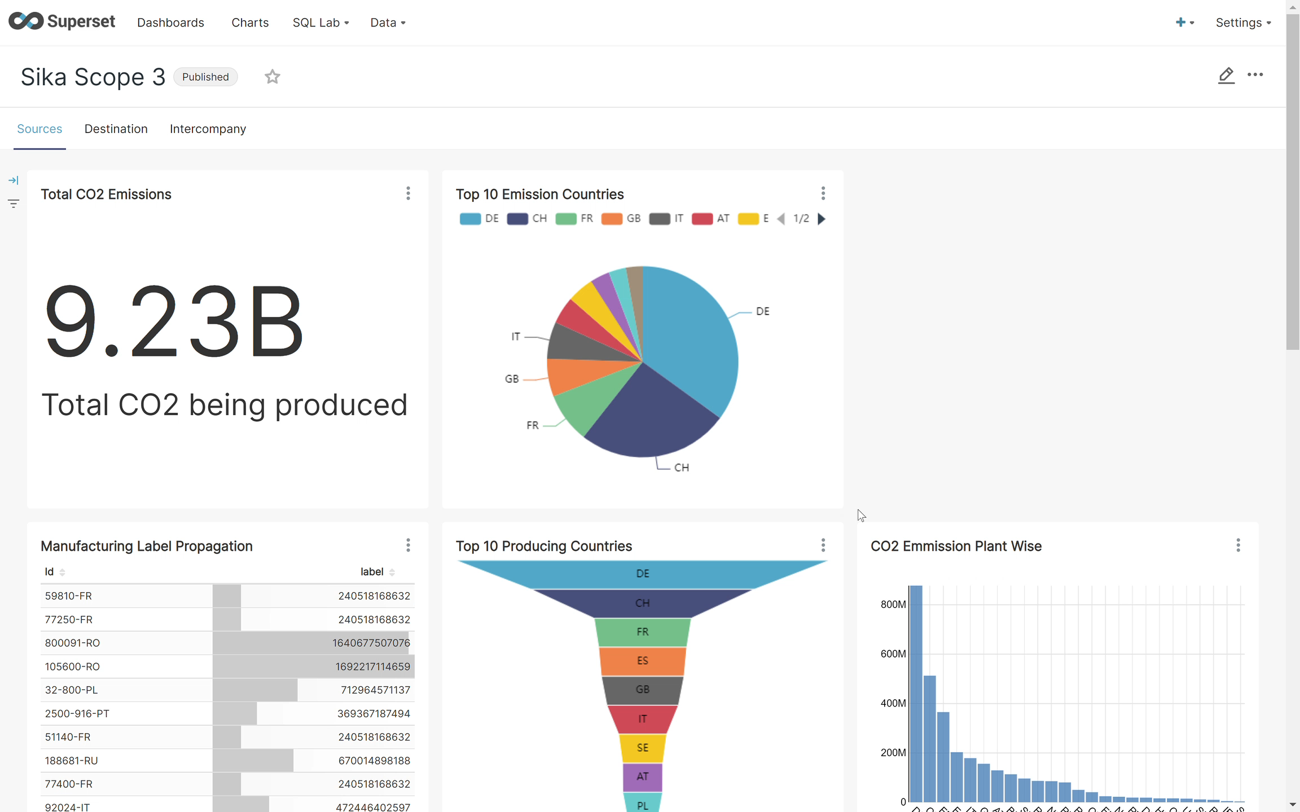


SERVING LAYER COMPONENTS
USING APACHE SUPERSET FOR DATA VISUALIZATION
8
Notes:
Superset was the best choice because it is user-friendly and easy to create built-in graphs with a minimal effort of coding.
Provides easy connectivity to Maria DB, linking the database to our visualization tool.

Slide 9
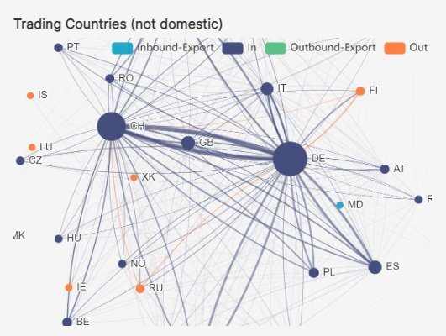
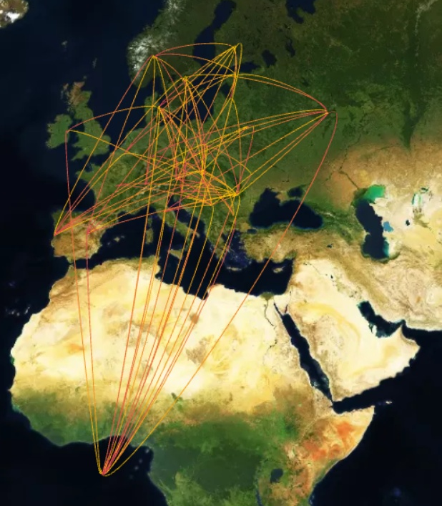

TRADING COUNTRIES
CONNECTION BETWEEN ORIGIN AND TRADING COUNTRY
DATA INSIGHTS
Through graph processing, we can scan understand the commercial relations between countries, which will help us find if there is any correlation between the routes, their commercial relation and the CO2 emissions.
Largest nodes are representing countries with their CO2 emissions, and we can see that Germany is the highest polluting country
Inbound Export: Emissions from purchases from other countries.
Outbound Export: Emissions from sales from other countries.
9

Slide 10

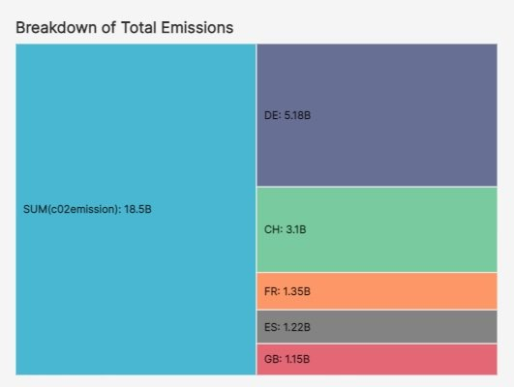
MOST POLLUTING COUNTRIES
TOP 10 POLLUTING COUNTRIES BASED ON TOTAL CO2 EMISSIONS
INSIGHTS
The total CO2 emissions: we can see that the total Co2 emissions for sika's operation is 9.3B
The CO2 emissions per location: we can see that Germany is the highest polluting country
10

Slide 11
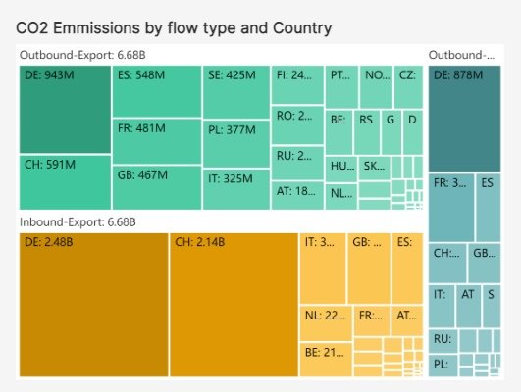
CO2 EMISSIONS BY FLOW TYPE AND COUNTRY
INBOUND AND OUTBOUND EMISSIONS BY COUNTRY
DATA INSIGHTS
Total CO2 emissions can be visualized by flow type (inbound/outbound) and the breakdown by countries.
Highest inbound emission is from Germany and of a total of 2.5B
Highest outbound emission is from Germany with a total of 934M
11

Slide 12
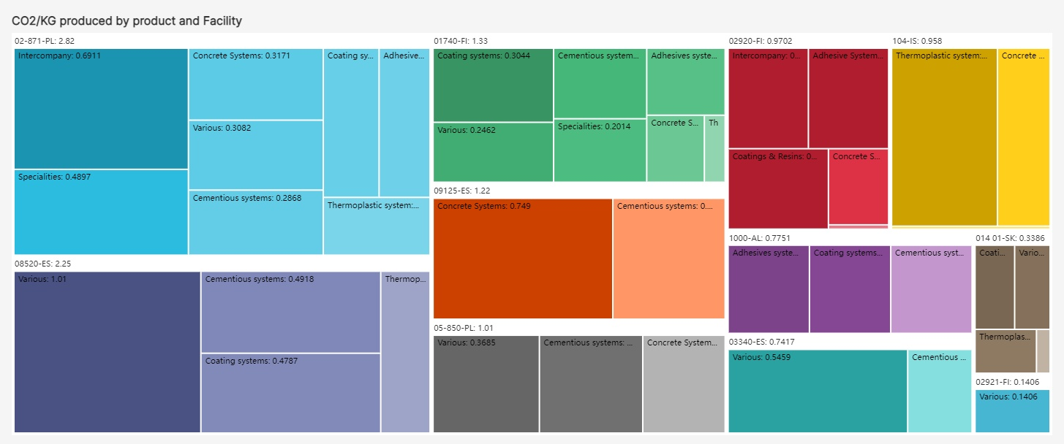
CO2 EMISSIONS BY PRODUCT TYPE
EMISSIONS PER KG FOR PRODUCTS PRODUCED BY EACH SIKA PLANT
DATA INSIGHTS
The treemap chart help us understand the most manufactured products for each Sika plant and the CO2 emissions associated with each KG produced.
Most polluting Sika plant is 02-871 with a total CO2 pollution index of 3.51
Cementious systems are probably the most manufactured and most costly to produce (emission wise) by all Sika's plants
12

Slide 13
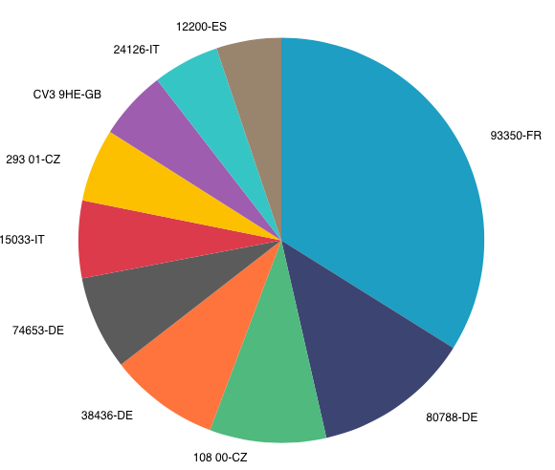
CO2 EMISSIONS BY FINAL DESTINATION PLANT
WHAT FINAL DESTINATIONS WE ARE EMITTING MORE C02?
DATA INSIGHTS
This pie chart graph is based on the destination plants and their CO2 emissions.
Largest share of CO2 goes to '93350' plant in France holds the biggest chunk of the pie.
13

Slide 14
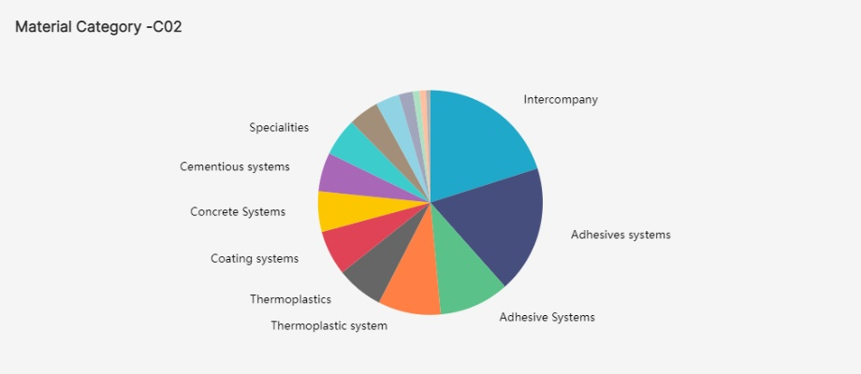
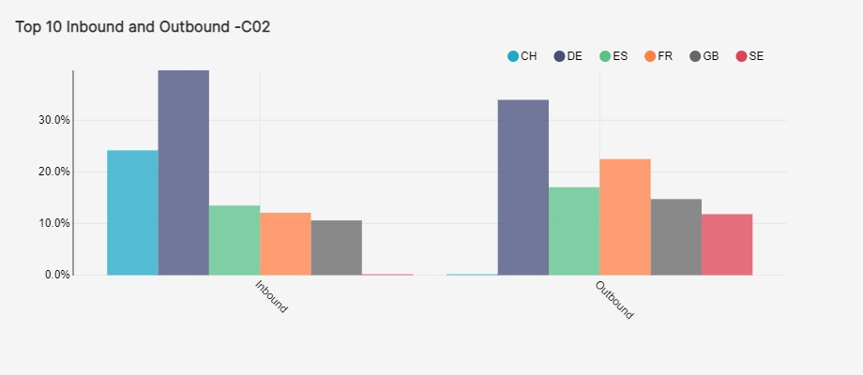
TOP EMISSIONS TOP EMISSIONS BY MATERIALS AND COUNTRY
DATA INSIGHTS
This Pie Chart shows that intercompany and adhesive systems contributes half of the Co2 emission
The top polluting countries in both inbound and outbound flows are CH,DE,ES,FR,GB,SE .
14

Slide 15
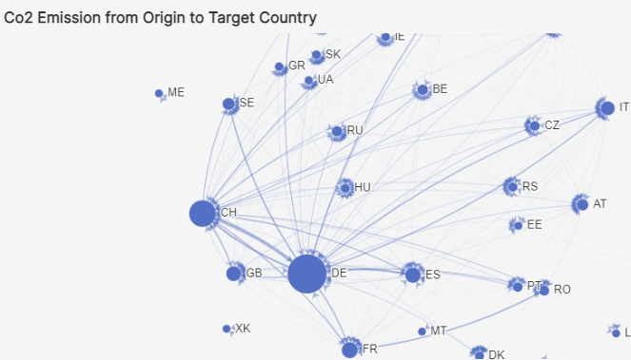
Data Visualization – Apache Superset Dashboard
DATA INSIGHTS
- This graph showing Co2 emission from origin to destination country
- The size of the circle denotes the magnitude of the Co2 emission
15

Slide 16
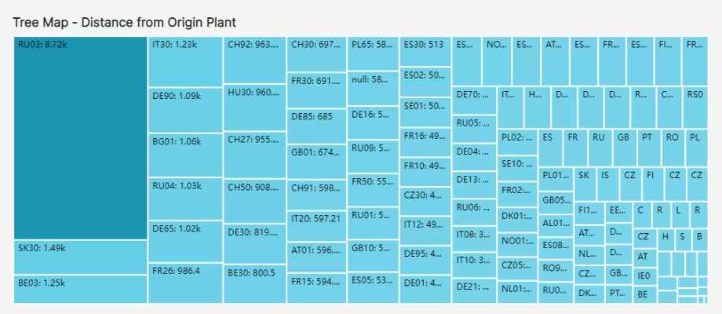
Data Visualization – Apache Superset Dashboard
-Distance depicted from Origin Plant(Source) to Destination Plant(Target)
16

Slide 17
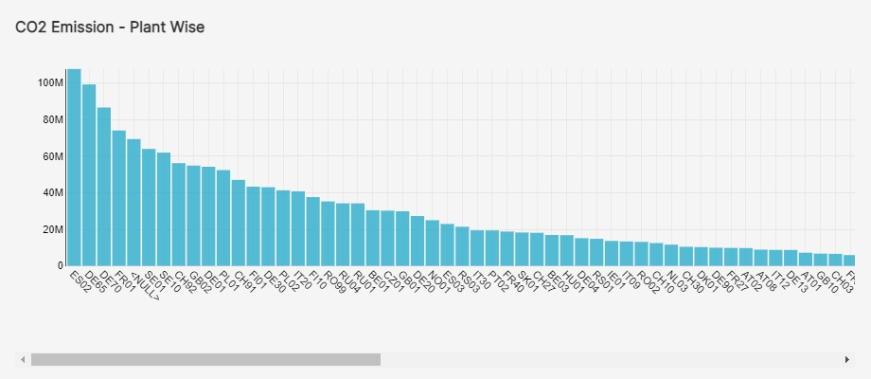
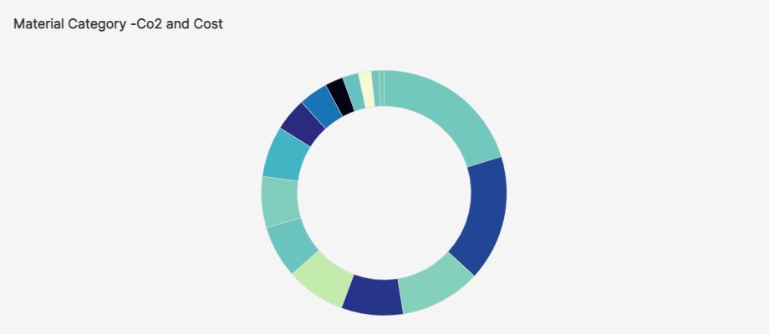

BUSINESS QUESTIONS
What is the most high-emitting plant that sika operates?
DATA INSIGHTS
The total CO2 emissions: we can see that the total Co2 emissions for sika's operation is 9.23B
The CO2 emissions per plant: we can see the highest emitting plan is ES02, in Spain.
The CO2 emissions per location: we can see that Germany is the highest polluting country
The CO2 emissions by material category and Amount:
Adhesive system,Intercompany and Thermoplastic categories more than half of C02 and Amount
17

Slide 18
PROJECT CONCLUSION (1/2)
FINAL RECOMMENDATIONS TO SIKA
Sites like Germany and Switzerland are on the top of the list in absolutes CO2 terms but Spain or UK if Kg handled are considered.
Outbound flows tend to have higher CO2 emission per Kg than Inbounds.
Coatings and Resins from Germany supplied to Italy, Spain and Portugal as well as Concrete Materials from UK to Italy and Spain have high emission per KG
Medium size companies such as Greece, Ukraine, Latvia or Bulgaria have a high outbound carbon footprint from Factories in Germany, Switzerland, UK and Spain. Main technologies involved: Adhesives, Coatings and Concrete systems.
Bidirectional flows has been found among some producing plants for similar technologies. Potentially redundant flows.
These areas of the supply chain would need a more detail analysis and Shortest path or Breadth-first search algorithms are available to optimize the routes among sources, plants and customers.
18

Slide 19
PROJECT CONCLUSION (2/2)
FINAL SUMMARY
Transportation network is highly complex. Graph processing and visualization helps significantly to understand and communicate the problem ,identify priorities and take actions.
The analysis allows to isolate the network among sources, plants and destination as well as separate the different supply chains based on technologies.
Geographical visualization on Maps makes the exploratory process much easier where graph algorithms allows to find insights and patterns
Several graph algorithms has been set up and ready to be used for further analysis on relationships, optimizations and clustering.
Relationships Analysis: Motif, Out-In Degree and PageRank
Optimization: Shortest paths, Breadth-first search
Clustering: Strongly connected components and Label Propagations
All these multiple outputs are easily consumed in the Scope 3 Dashboard on Superset.
19
Notes:
Put like Append. ¿?

Slide 20
THANK YOU

